Slide 1
Happiness
a writing experience

Slide 2

“Happiness is the meaning and the purpose of life, the whole aim and end of human existence”
--Aristotle said this. Do you agree?

Slide 3

"Who said you should be happy?
Do your work."
Colette said this. Does she have a point?

Slide 4

“If you want to live a happy life, tie it to a goal, not to people or things.”
Albert Einstein said this. Would you take his advice?

Slide 5

“Happiness is not the absence of problems but the ability to deal with them.”
This is an anonymous statement about happiness. Is it true?

Slide 6

“There is only one happiness in this life, to love and be loved.”
George Sand said this. What do you think?

Slide 7
Now that you know what others have said...
It's time to develop your own ideas.
Think about it.
Talk about it.
Use a mind map.
Do some research.
See what information you can find.

Slide 8
Develop a research question.
The answer can be your thesis.

Slide 9
Is happiness under our control?
maybe
maybe not
One global study concluded that the causes of happiness can be identified.
One long-term study found that people's happiness didn't depend on their circumstances.

Slide 10
Once you have a question, look for an answer.
Do preliminary research on the internet.
Visit the library and find some sources.
Interview some experts.
Develop a hypothesis -- a tentative answer to your question.

Slide 11
Keep track of your sources as you go.
Rath, Tom and Jim Harter. Wellbeing: The Five Essential Elements. New York: Gallup Press, 2010. Print.
Looks at five aspects of well being (career, social, financial, physical, and community) with research and recommendations for increasing them.

Slide 12
Identify quotes with quotation marks.
Henslin, Earl, and Daniel G. This Is Your Brain on Joy: A Revolutionary Program for Balancing Mood, Restoring Brain Health, and Nurturing Spiritual Growth. Nashville: Thomas Nelson Inc, 2009. 54. Print.
"When you are totally immersed in learning something new... your brain buzzes with joy."

Slide 13
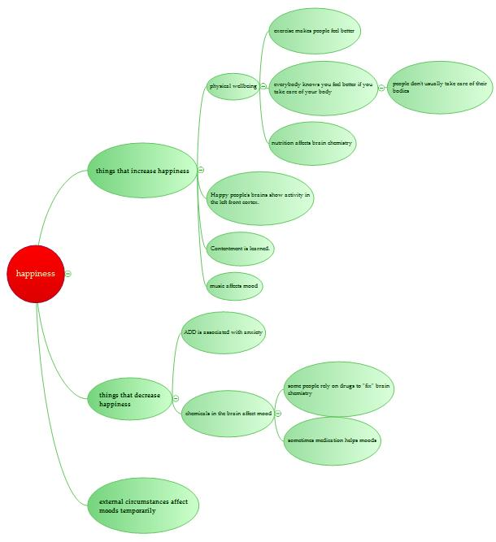
Organize your thoughts and information into an outline.
Physical wellbeing is essential for happiness.
I. Chemical and physical changes in the brain affect happiness.
II. Healthy habits create positive changes in the brain.
A. Nutrition affects brain function.
B. Exercise affects mood.
C. Sleep affects brain function.
III. Unhealthy habits create negative changes in the brain.
A. Drug use affects brain function.
B. Negative thought patterns affect mood.

Slide 14

Organize all your notes and sources.
Have your supporting evidence ready when you write.

Slide 15

Write a draft of your paper.
Then set it aside for a while. Go back and edit it. Don't forget to proofread!

Slide 16

Congratulations!
You've written a successful paper. Did it make you feel happy?

Slide 17
Rebecca Haden
Northwest Arkansas Community College

